Slide 1


4 Metrics
Guido Borghi, PhD
guido.borghi@unibo.it

Slide 2
4.1 Base metrics
For Classification and Regression tasks

Slide 3
Machine Learning pipeline
In these slides we focus on the last step, or on the prediction of the system.
This step is extremely important as:
It is the output you are dealing with and with which you actually use the system.
It allows us to calculate the performance of the system through metrics, to understand if the system responds correctly with respect to what was designed and desired.
The computation of metrics is also linked to the achievement of certain contractual obligations
Legal aspects are among the most important aspects of a company's project
DATA ACQUISITION
DATA PROCESSING
MODEL
PREDICTION

Slide 4
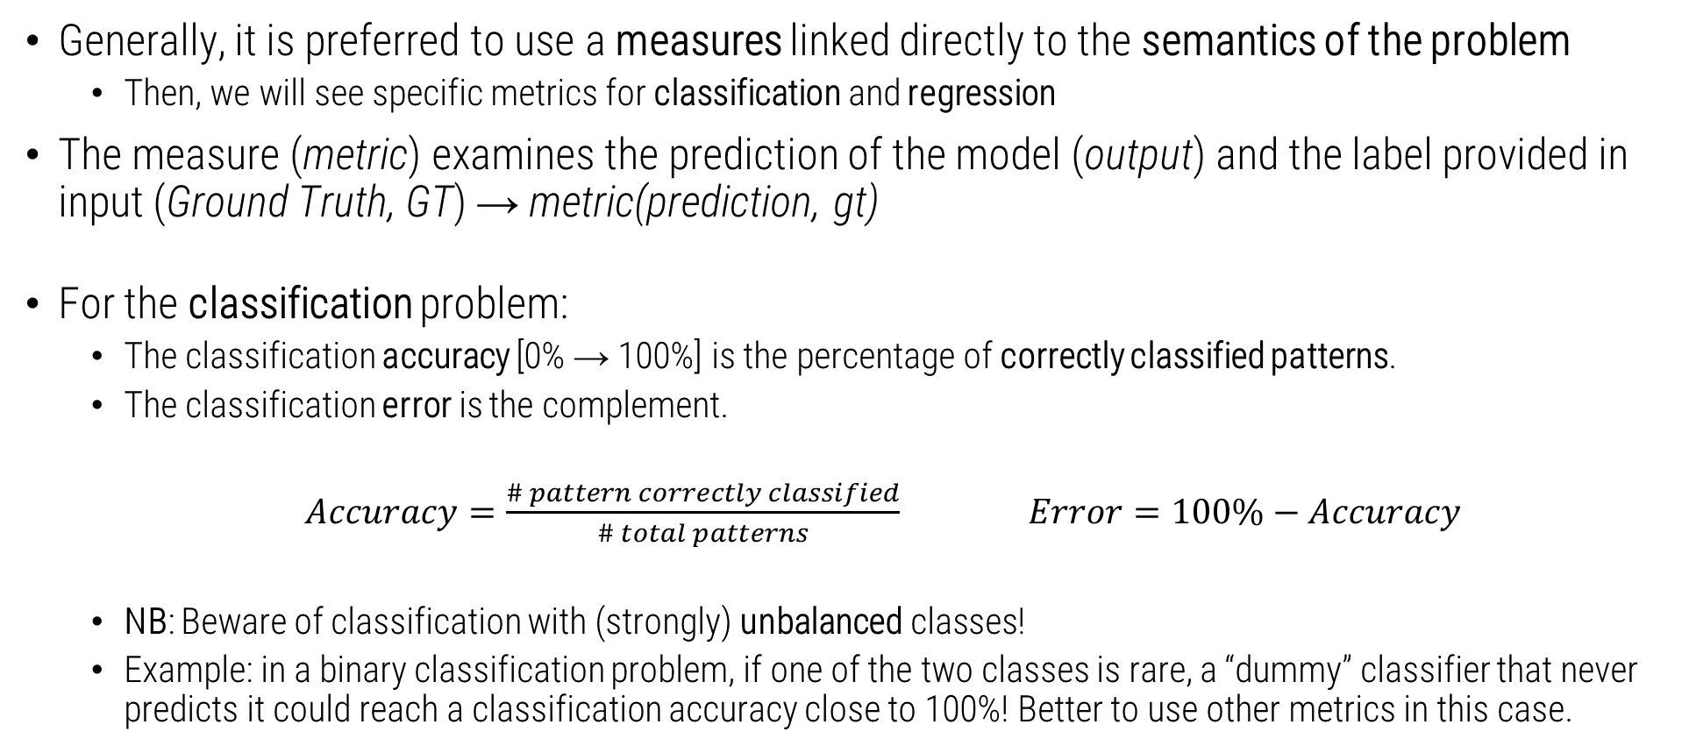
System performance with Classification
Generally, it is preferred to use a measures linked directly to the semantics of the problem
Then, we will see specific metrics for classification and regression
The measure (metric) examines the prediction of the model (output) and the label provided in input (Ground Truth, GT) → metric(prediction, gt)
For the classification problem:
The classification accuracy [0% → 100%] is the percentage of correctly classified patterns.
The classification error is the complement.
$Accuracy=\frac{\# pattern correctly classified}{\# total patterns}$ $Error=100\%−Accuracy$
NB: Beware of classification with (strongly) unbalanced classes!
Example: in a binary classification problem, if one of the two classes is rare, a “dummy” classifier that never predicts it could reach a classification accuracy close to 100%! Better to use other metrics in this case.

Slide 5



Example of Classification
Let's imagine we have a series of predicted values ​​and their relative GT values
Accuracy:
“Dog” correctly classified: 4
“Cat” correctly classified: 2
$$\frac{5+3}{10}=\frac{8}{10}=0.8→80\%$$
Predicted values | GT
Dog | Dog
Cat | Cat
Cat | Cat
Dog | Dog
Dog | Cat
Cat | Cat
Dog | Dog
Dog | Dog
Cat | Dog
Dog | Dog

Slide 6

Example of Classification
Let's imagine we have an unbalanced series of predicted values ​​and their relative GT values
Predicted values | GT
Dog | Dog
Cat | Cat
Cat | Cat
Dog | Dog
Dog | Cat
Cat | Cat
Dog | Dog
Dog | Dog
Cat | Dog
Dog | Dog
Cat | Mouse
Accuracy:
“Dog” correctly classified: 4
“Cat” correctly classified: 2
“Mouse” correctly classified: 0
$$\frac{5+3}{11}=\frac{8}{11}=\sim 73\%$$
If we had an eleventh example of the “mouse” class, incorrectly classified as "cat", we would always have a very high accuracy (73%), but we might not realize that the system is not able to classify this class.

Slide 7
Confusion Matrix
The confusion matrix is ​​very useful in multiclass classification problems to understand how errors are distributed
In the example, a digit classification problem is considered: 10 classes (0 → 9)
Rows: classes of GT
Columns: predicted classes
A cell (r,c) shows the percentage in which the system predicts class c for a ground truth class r
Ideally, the matrix should be diagonal. High (off-diagonal) values ​​indicate concentrations of errors.
In the example, the class “0” is often confused with “6” (6 is similar to the “0”!)

Slide 8
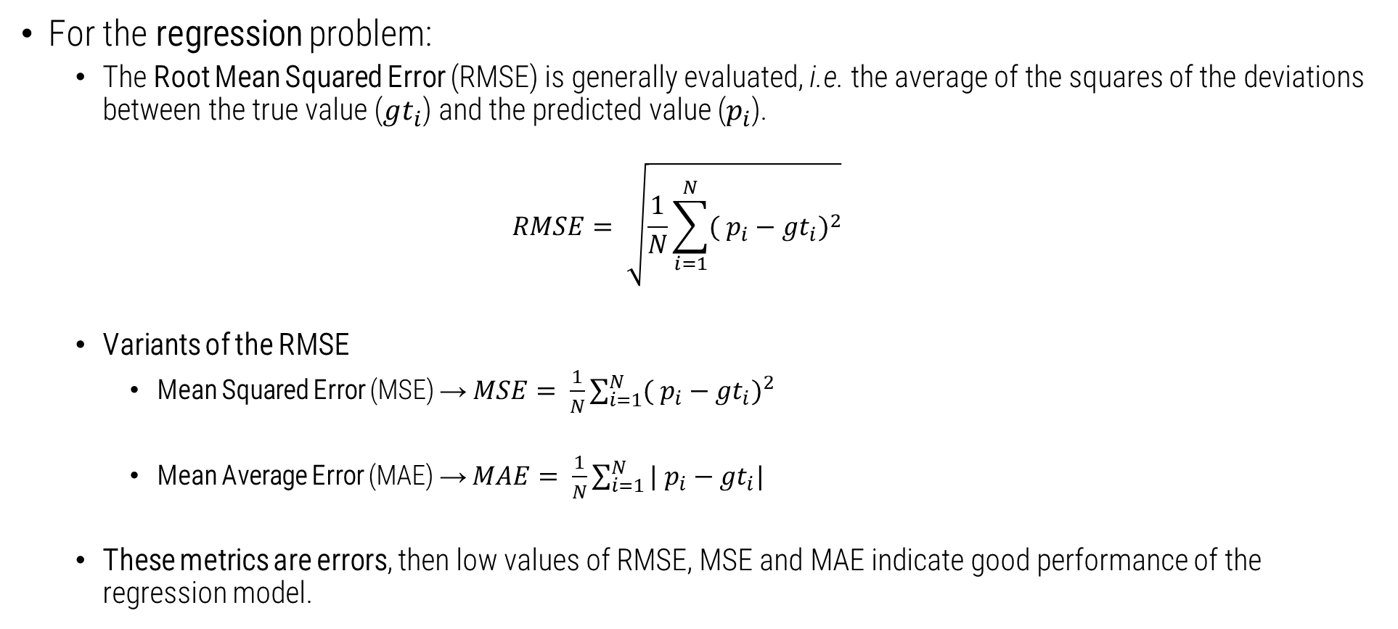
System performance with Regression
For the regression problem:
The Root Mean Squared Error (RMSE) is generally evaluated, i.e. the average of the squares of the deviations between the true value (${gt}_{i}$) and the predicted value ($p_{i}$).
$$RMSE= \sqrt{\frac{1}{N}\sum_{i=1}^{N}{{( p_{i}−{gt}_{i})}^{2}}}$$
Variants of the RMSE
Mean Squared Error (MSE) → $MSE= \frac{1}{N}\sum_{i=1}^{N}{{( p_{i}−{gt}_{i})}^{2}}$
Mean Average Error (MAE) → $MAE= \frac{1}{N}\sum_{i=1}^{N}{{| p_{i}−{gt}_{i}|}^{}}$
These metrics are errors, then low values ​​of RMSE, MSE and MAE indicate good performance of the regression model.

Slide 9
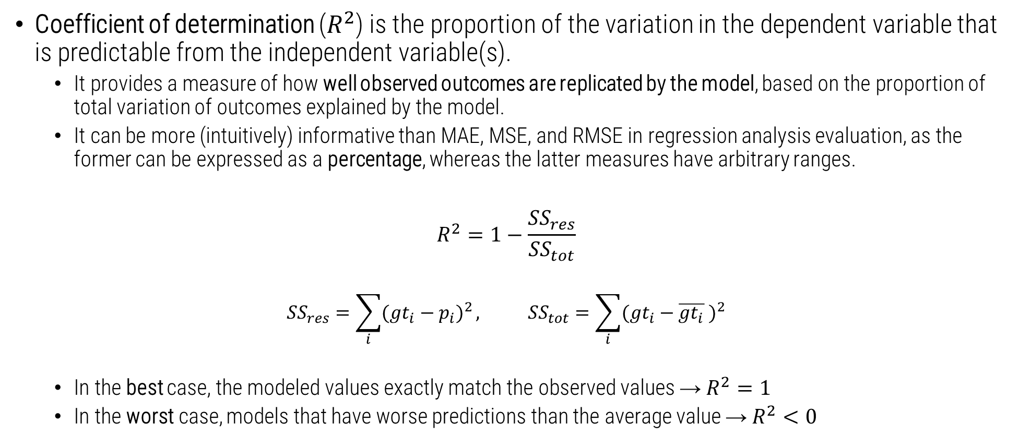
System performance with Regression
Coefficient of determination ($R^{2}$) is the proportion of the variation in the dependent variable that is predictable from the independent variable(s).
It provides a measure of how well observed outcomes are replicated by the model, based on the proportion of total variation of outcomes explained by the model.
It can be more (intuitively) informative than MAE, MSE, and RMSE in regression analysis evaluation, as the former can be expressed as a percentage, whereas the latter measures have arbitrary ranges.
$$R^{2}=1−\frac{{SS}_{res}}{{SS}_{tot}}$$
$${SS}_{res}=\sum_{i}{{({gt}_{i}−p_{i})}^{2}}, {SS}_{tot}=\sum_{i}{{({gt}_{i}−\overline{{gt}_{i}} )}^{2}}$$
In the best case, the modeled values exactly match the observed values → $R^{2}=1$
In the worst case, models that have worse predictions than the average value → $R^{2}<0$
Residual sum
of squares
Total sum
of squares
https://en.wikipedia.org/wiki/Coefficient_of_determination

Slide 10

Example of Regression
Let's imagine we have a series of predicted values ​​and their relative GT values
We are in the case of the regression, for which the values ​​of GT (our labels) are integer values.
We can compute:
MSE = ((14 - 12)² + (15 - 15)² + (18 -20)² + (19 - 16)² + (25 - 20)² + (18 - 19)² + (12 - 16)² + (12 - 20)² + (15 - 16)² + (22 - 16)²) / 10 = 16
RMSE = 16^{1/2} = 4
MAE = (|14 – 12| + |15 – 15| + |18 -20| + |19 – 16| + |25 – 20| + |18 – 19| + |12 – 16| + |12 – 20| + |15 – 16| + |22 – 16|) / 10 = 3.2
$R^{2}$ = 1 – (160/186) = 1 – 0.86 = 0.14
The root of the mean of the square of the differences, being the mean of the deviation, is easier to understand w.r.t MSE and MAE.
Predicted values | GT
14 | 12
15 | 15
18 | 20
19 | 16
25 | 20
18 | 19
12 | 16
12 | 20
15 | 16
22 | 16

Slide 11
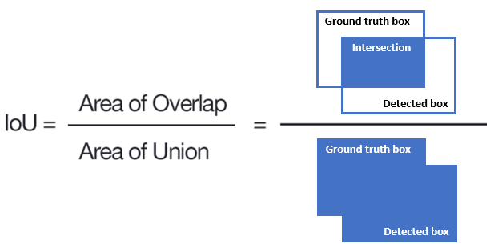
System performance
For the Object Detection problem: for each present object it determines the probability of belonging to the most probable class and the corresponding bounding box.
Possible different types of errors including object not found, wrong class, wrong or inaccurate bounding box.
How to quantify everything with a scalar to make systems comparable?
Average Precision (AP) it is a sort of AUC calculated on a Recall / Precision graph for objects of a single class on the whole database.
Medium Average Precision (mAP) is the average of AP over all classes
To calculate TP, FP (with a certain confidence) we consider a correct prediction when the class is right and the Intersection over Union (IoU) of the two bounding boxes.

Slide 12
4.2 Advanced Metrics
For Classification

Slide 13
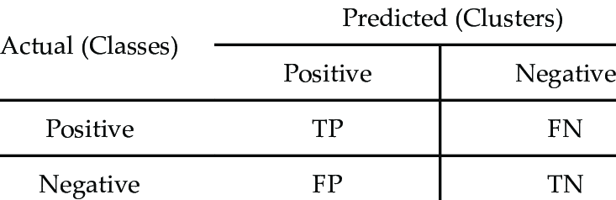
Performance Assessment
Given a binary classification and T = P (positive) + N (negative) patterns to be classified, we can define:
True Positive (TP): a positive pattern is correctly assigned to the positives
True Negative (TN): a negative pattern is correctly assigned to the negatives
False Positive (FP): a negative pattern is incorrectly assigned to positives
False Negative (FN): a positive pattern is incorrectly assigned to the negatives

Slide 14

Performance Assessment
Given these definitions, we can define the following metrics:
TPR (True Positive Rate) → $TPR=\frac{TP}{P}$
TNR (True Negative Rate) → $TNR=\frac{TN}{N}$
FPR (False Positive Rate) → $FPR=\frac{FP}{P}$
FNR (False Negative Rate) → $FNR=\frac{TN}{N}$
With this notation, the classification accuracy can be written as:
$$Accuracy= \frac{TP+TN}{T=P+N}$$

Slide 15
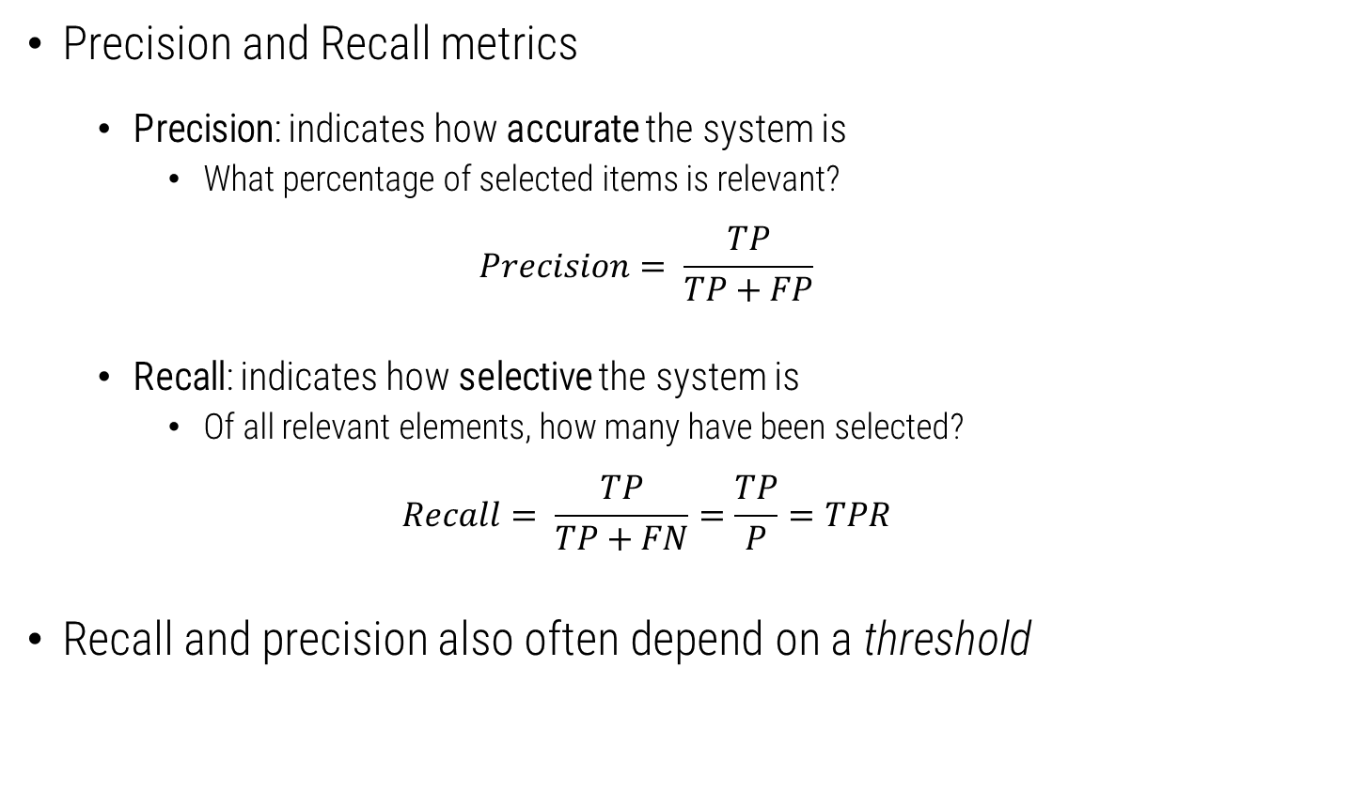
Performance Assessment
Precision and Recall metrics
Precision: indicates how accurate the system is
What percentage of selected items is relevant?
$$Precision= \frac{TP}{TP+FP}$$
Recall: indicates how selective the system is
Of all relevant elements, how many have been selected?
$$Recall= \frac{TP}{TP+FN}=\frac{TP}{P}=TPR$$
Recall and precision also often depend on a threshold

Slide 16
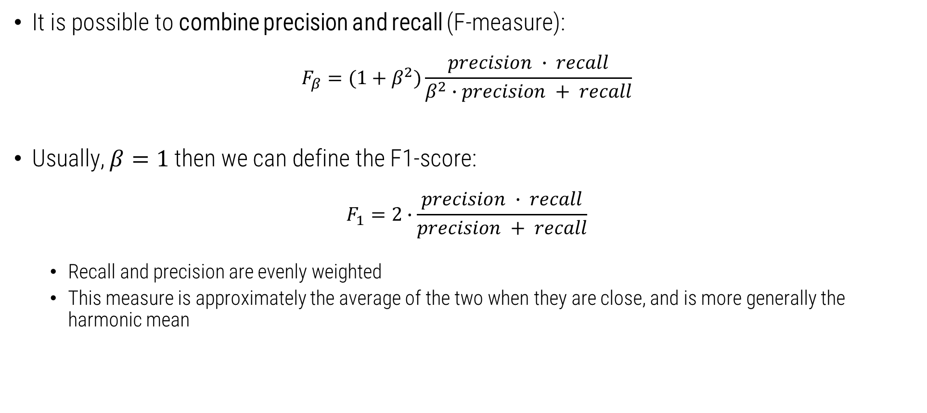
Performance Assessment
It is possible to combine precision and recall (F-measure):
$$F_{β}=(1+β^{2})\frac{precision ∙ recall}{β^{2}∙precision + recall}$$
Usually, $β=1$ then we can define the F1-score:
$$F_{1}=2∙\frac{precision ∙ recall}{precision + recall}$$
Recall and precision are evenly weighted
This measure is approximately the average of the two when they are close, and is more generally the harmonic mean

Slide 17
4.3 Metrics for systems based on thresholds

Slide 18
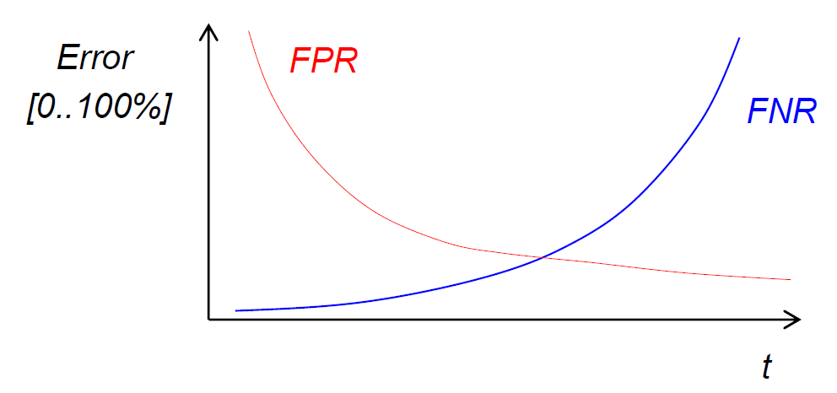
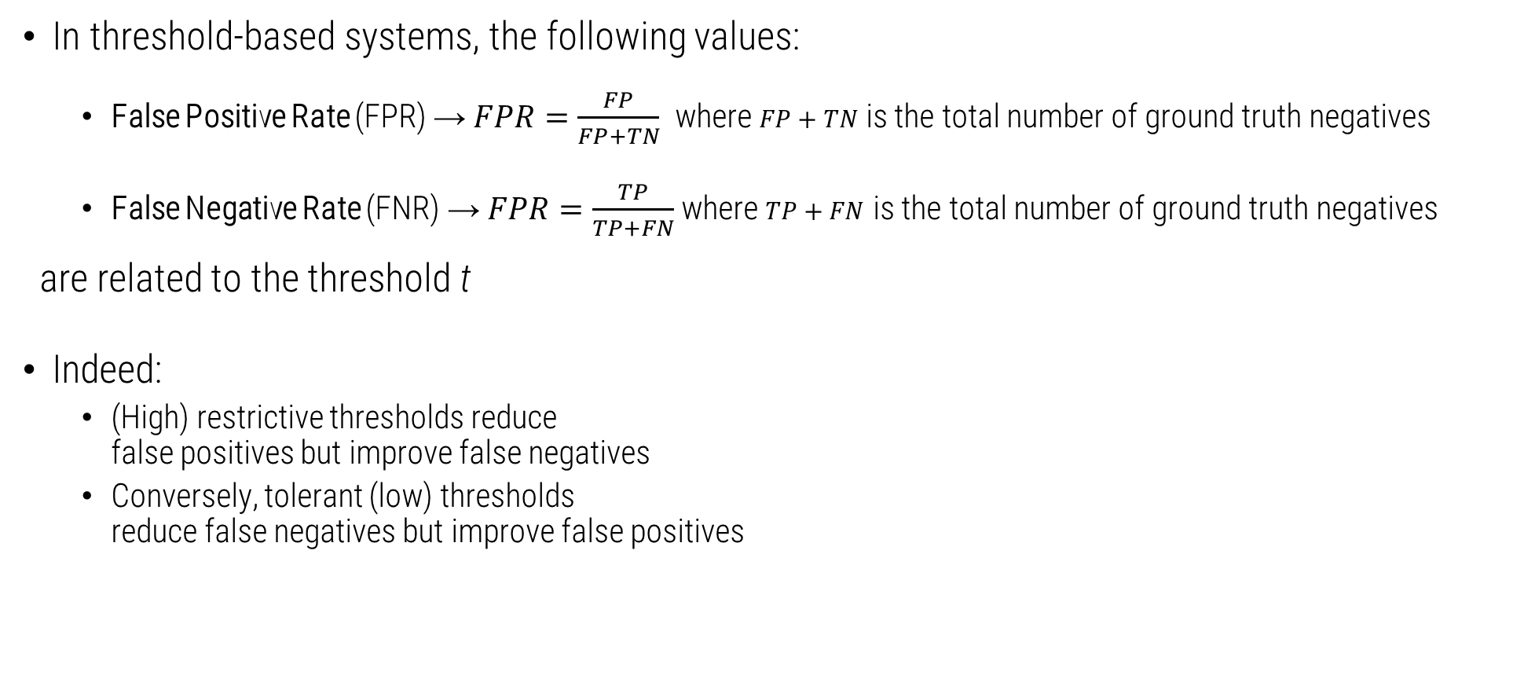
Threshold-based Systems
In threshold-based systems, the following values:
False Positive Rate (FPR) → $FPR=\frac{FP}{FP+TN}$ where $FP+TN$ is the total number of ground truth negatives
False Negative Rate (FNR) → $FPR=\frac{TP}{TP+FN}$ where $TP+FN$ is the total number of ground truth negatives
are related to the threshold t
Indeed:
(High) restrictive thresholds reduce false positives but improve false negatives
Conversely, tolerant (low) thresholds reduce false negatives but improve false positives

Slide 19
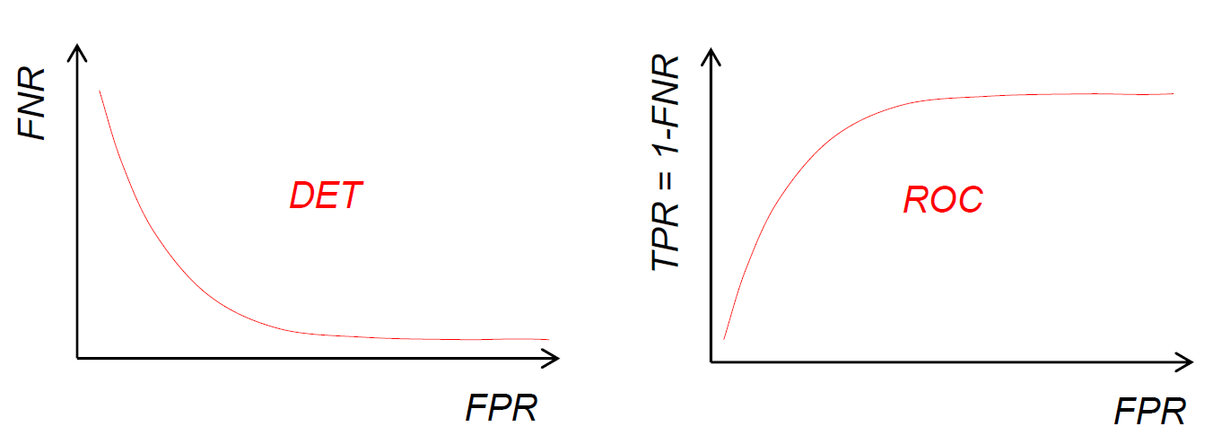
Threshold-based Systems
Then, to monitor performance of threshold-based systems, we can define two curves:
Detection Error Tradeoff (DET) curve
x-axis: FPR
y-axis: FNR
The threshold t is not visible
Receiver Operating Characteristic (ROC) curve
x-axis: FPR
y-axis: TPR = 1 - FNR
ROC is overturned vertically with respect to DET

Slide 20
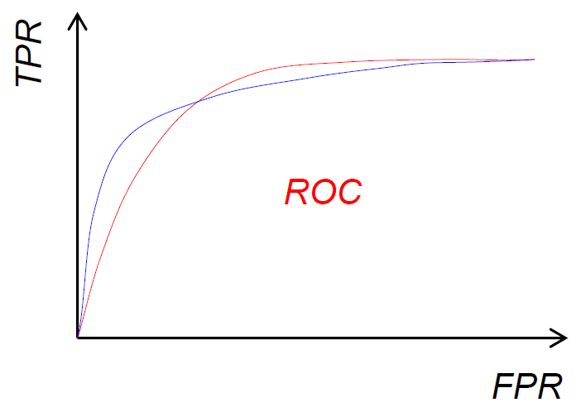
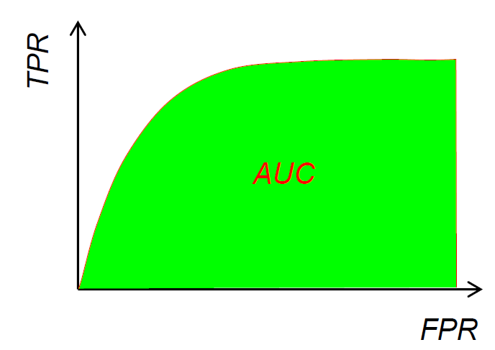
Threshold-based Systems
Comparing the curves obtained is often not easy.
For example, which of the two systems (red and blue) shown on the side is better than the other?
The best system is the one whose curve is "higher", but in this case the curves intersect, and the optimality depends on the desired working point.
A comparison can be made by «mediating» on the different working points of the system.
The area under the ROC curve (it is a scalar in [0→1]) characterizes the average performance (the higher, the better)
It can be calculated as a numerical integral.

Slide 21
4.3 Data and Metrics
On which data compute metrics

Slide 22
On which data compute metrics
Remember the distinction between training and testing sets
On the training set the model training phase is conducted
On the testing set the testing phase of the model is conducts (with the metrics introduced)
Remember also the notion of validation set:
It is a set that is usually part of the training set, it is a subset of it.
It is the portion of data on which the metrics are calculated during training
It is used to calibrate the hyperparameters, the parameters that influence the model
The temptation to calibrate the hyperparameters on the test set is always strong, but this should be avoided, under penalty of overestimating the performance.
In ML benchmarks, the division of patterns into train, val and test is often predefined to make the results comparable → but what to do when the training set is problematic? (for instance, it is strongly limited in size)

Slide 23
Validation of the model
If the validation set is too small, then model evaluations will be imprecise.
K-fold cross-validation:
With few data, a more robust choice of hyperparameters is obtained with the k-fold cross-validation
How to implement k-fold:
Define parameter k → the train data are divided into k parts (of equal number)
For k times:
The model is trained on k-1 parts, the rest is used as a validation set
The accuracy is calculated as the average or median of the k tests
The hyperparameter configuration that offers the best mean or median is chosen
Once the optimal hyperparameters have been chosen, the model is re-trained on the entire training set and, only at this point, does the performance on the test set occur.

Slide 24
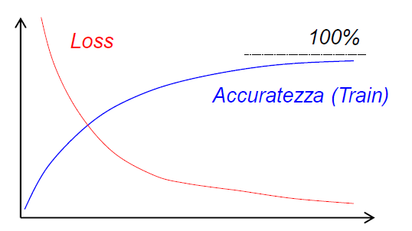
Validate the model
Leave-one-out (LOO):
“Extreme case” of the cross validation where folds have size k=1
Given the computational cost, it is used when the patterns are few (a few hundred)
Convergence:
The first goal to be pursued during training is the convergence on the training set
We have convergence when:
The output of the loss function has a decreasing trend
Accuracy has an increasing trend
If the loss does not decrease (or significantly fluctuate) the system does not converge, the optimization method is not effective, the hyperparameters are out of range, the learning rate is inadequate, the are implementation errors, …
If the loss decreases but the accuracy does not increase probably the wrong loss function was chosen
Accuracy

